Slide 1
Looking for fun & easy meals & snacks that you can make with your family?

Slide 2
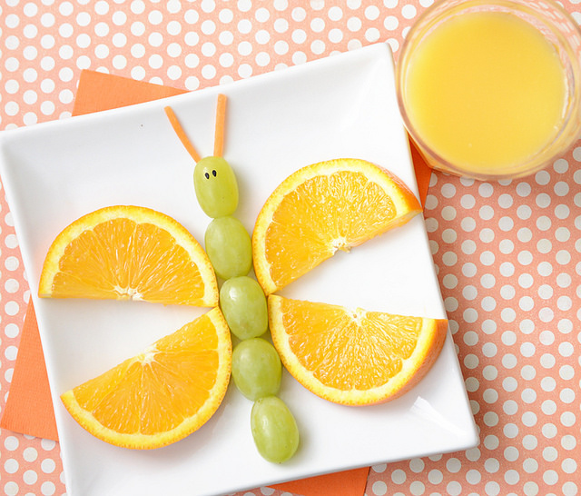

Slide 3
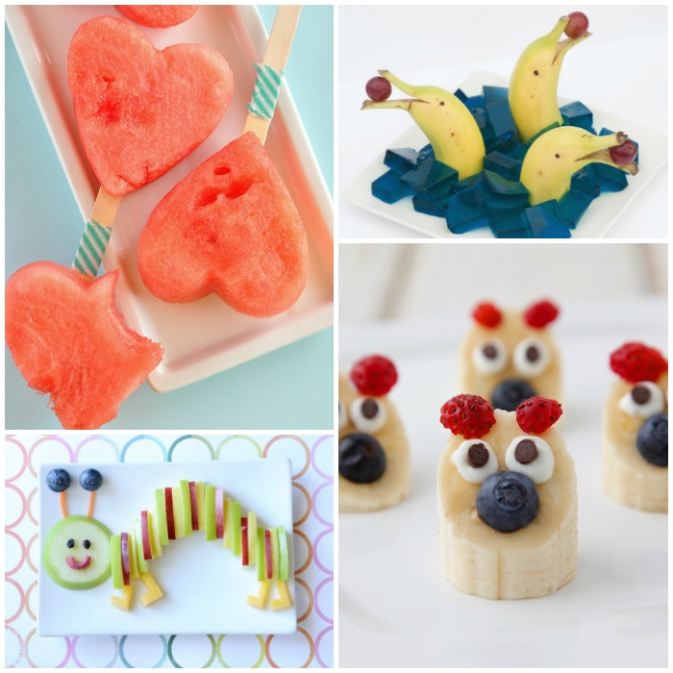

Slide 4
